Slide 1
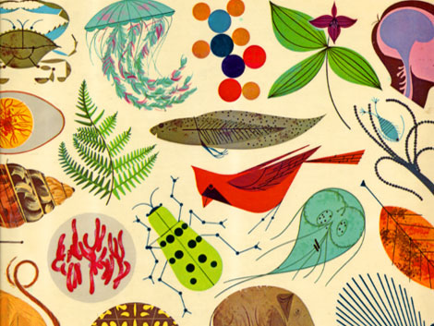
Biology 1202
“LIVE”
General Biology Lecture II for Science Majors

Slide 2

This presentation is best viewed in “slide show” mode since there are embedded animations and overlay slides. Click the projector icon while in PowerPoint to view in “slide show” mode.

Slide 3
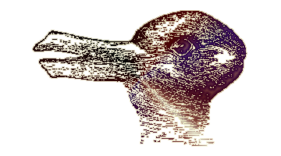
What do you see in this picture?
What did you see? A rabbit or a duck? It all depends on how you look at it.

Slide 5
What did you see?
Old man with glasses…
Or the word “LIAR”…

Slide 6
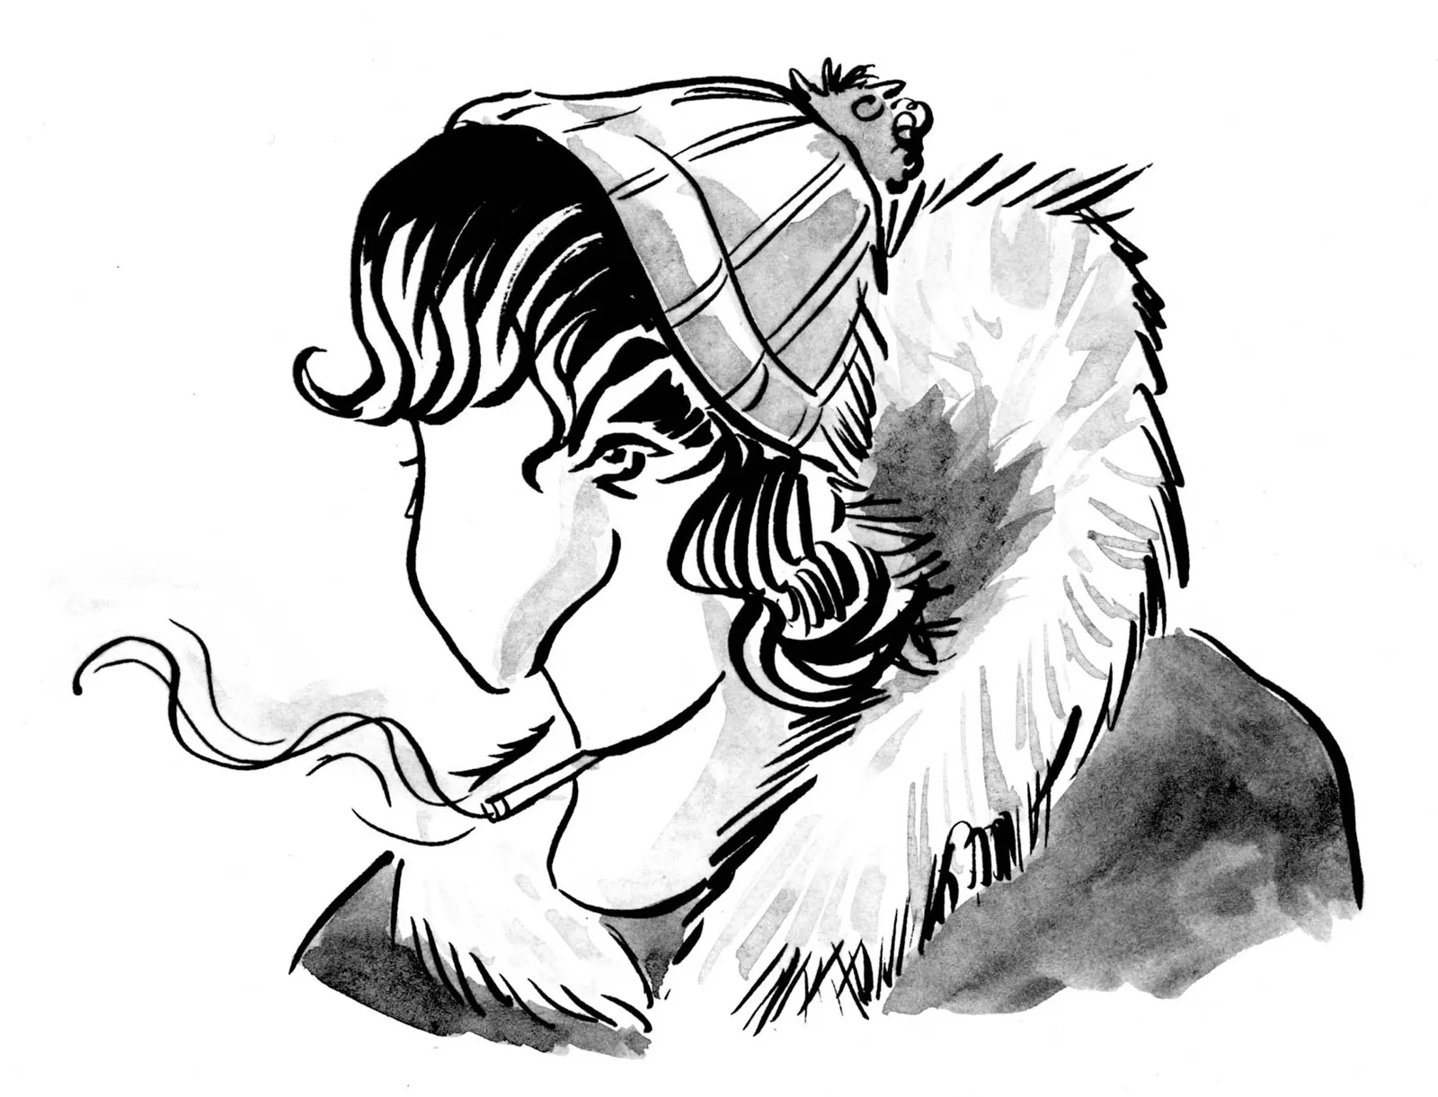
What do you see?
A young girl with a scarf and necklace or a woman smoking a cigarette?

Slide 7
Try to think about BIOL 1202 as viewing life a bit differently. Perhaps from a different angle than you have in the past.
Some things are not always as they appear…

Slide 8

The following figures are completely
stationary and NOT animated

Slide 9


Slide 10
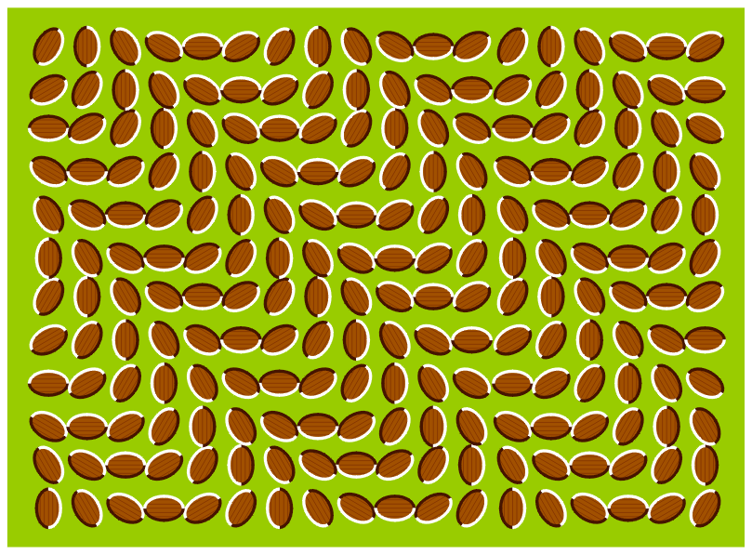
So is this one…

Slide 11


Slide 12


Slide 13
The Hidden Tiger Optical Illusion
The objective is to find “The Hidden Tiger” in the following image
Once you see it, it seems so obvious…or is it?

Slide 14
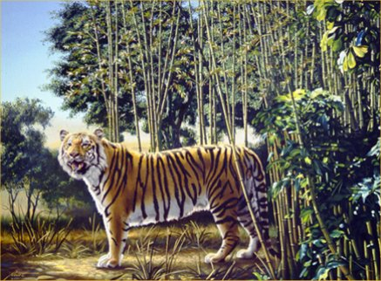

Slide 15
Say the actual color of the words below (and not what the text spells). Try to do it as fast as you can.

Slide 16
Red green blue purple orange
blue red purple orange green
orange blue red green purple
purple green blue orange red
blue red purple green orange
When you try to say the colors aloud, it is very hard to avoid reading the word. If the two bits of information conflict, your brain struggles to work out what the correct answer is, and it takes longer. This is called ‘The Stroop effect’ and was discovered in 1935 by John Ridley Stroop.

Slide 17
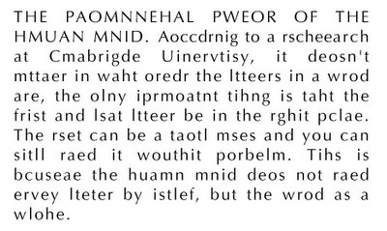
Try reading the text below. Is it difficult to do so?
A person can read this text with little effort if the first and last letters of the word are correctly placed.

Slide 18
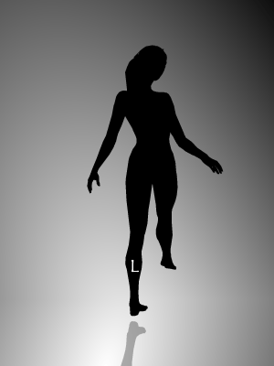
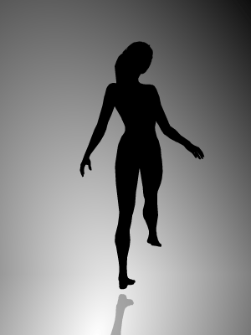
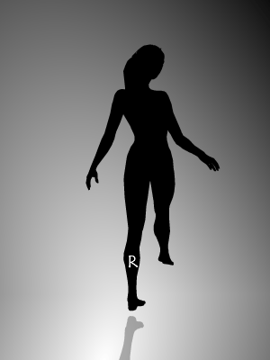
Which way is the dancer spinning?
Clockwise or counter-clockwise? Are you sure….?
CLOCKWISE
COUNTER-CLOCKWISE
CLOCKWISE
Notes:
When trying to switch from clockwise to counterclockwise wise I have found focusing on the shadow of her foot for a couple seconds allows you to see the opposite direction. And in some cases when able to switch back and forth with ease it looks like she is waving her leg back and forth and has lost the spinning effect entirely.

Slide 19

Are the two rectangles the same or different shades of purple?

Slide 20

Does the orange circle remain the same size the whole time?
Yes! The orange circle doesn’t actually change size.

Slide 21
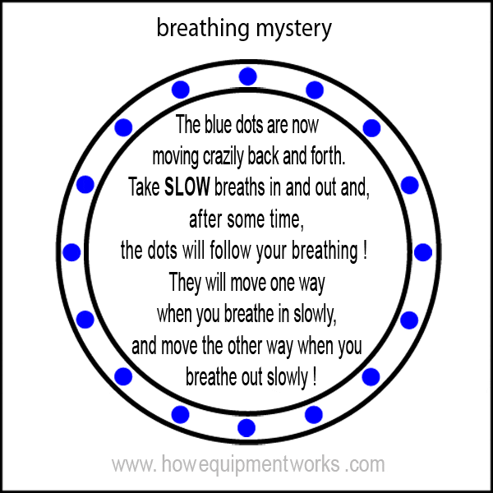

Slide 22

OK, so who is this guy….

Slide 23
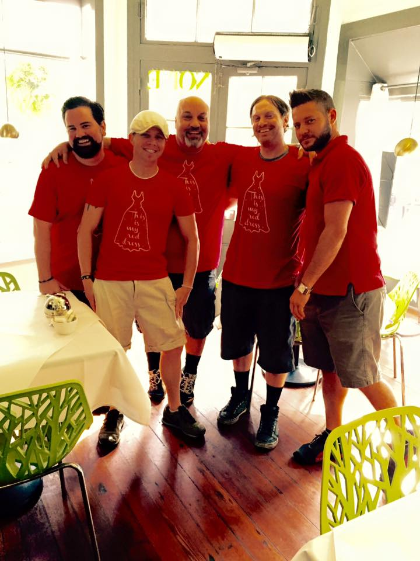
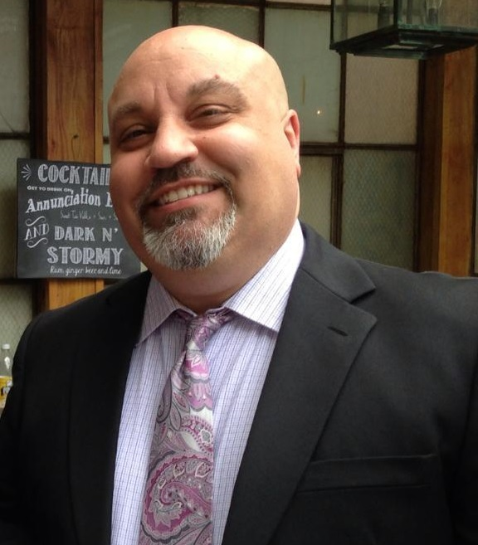
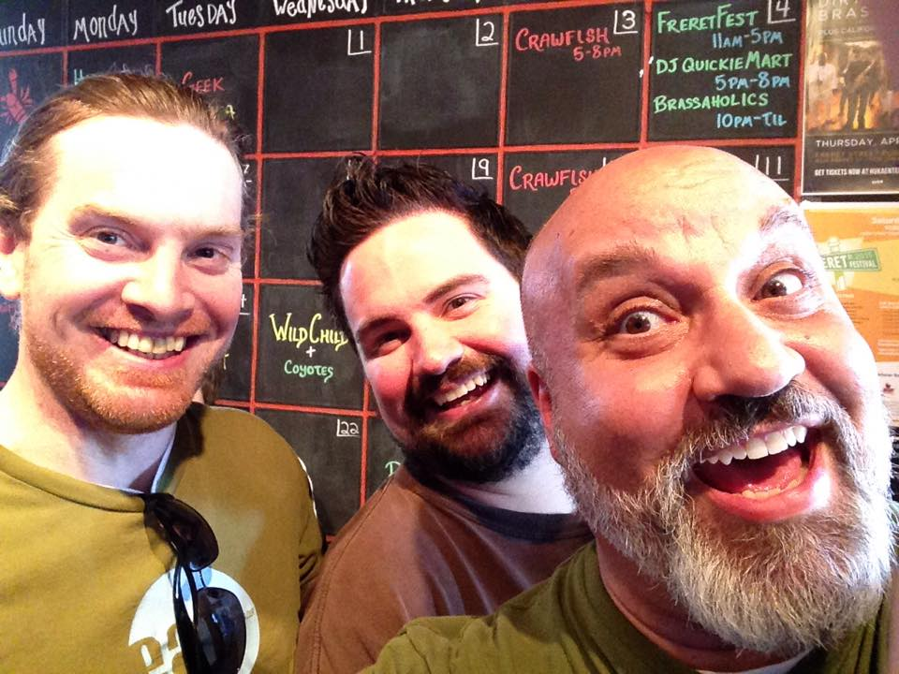
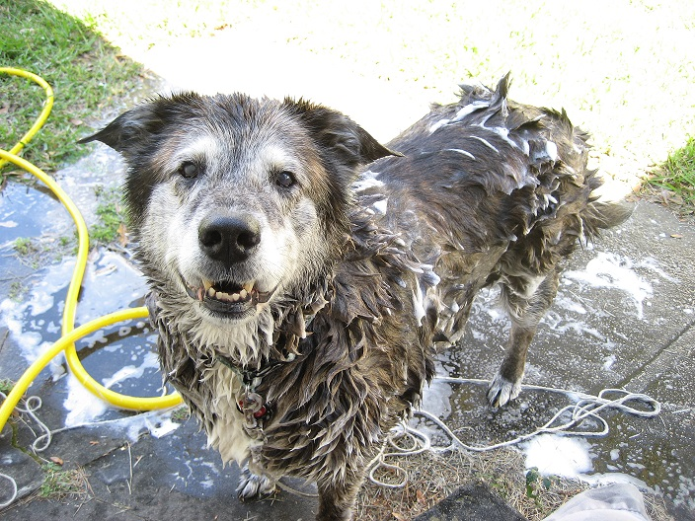
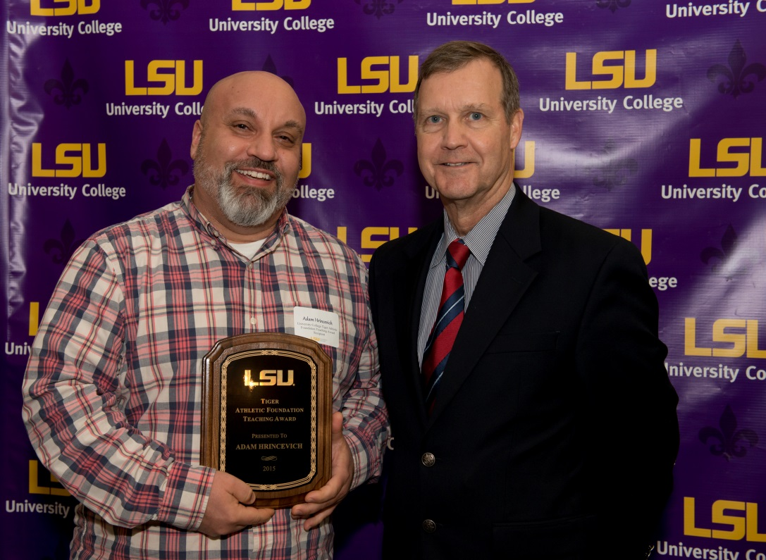

Slide 24
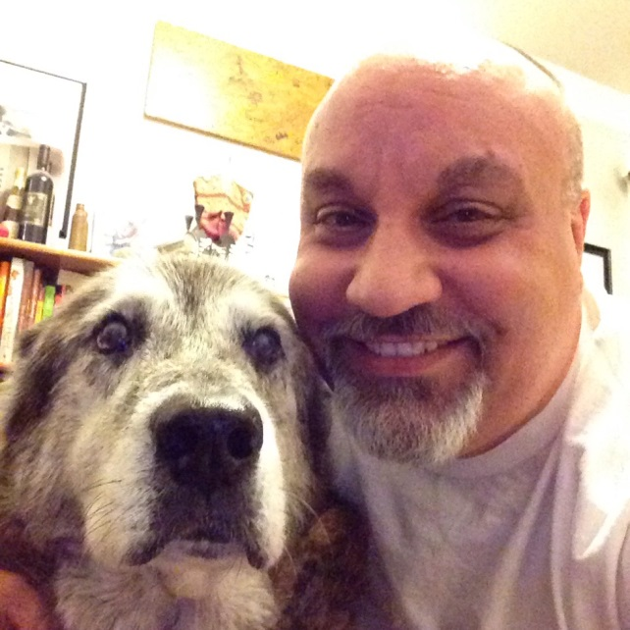
Dr. Adam Hrincevich
Pronounced “her-IN-suh-vitch”
Hrincevich ??? Say again????
(I know…you saw my name on the list of classes and thought “there is no way this person speaks English. Just great…”)

Slide 25
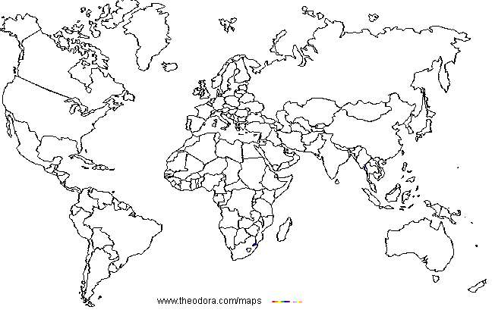
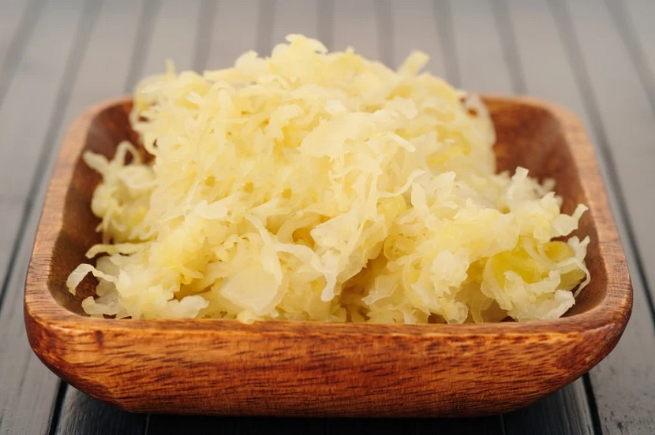
Hrincevich???

Slide 26
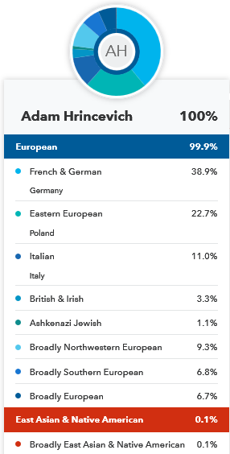
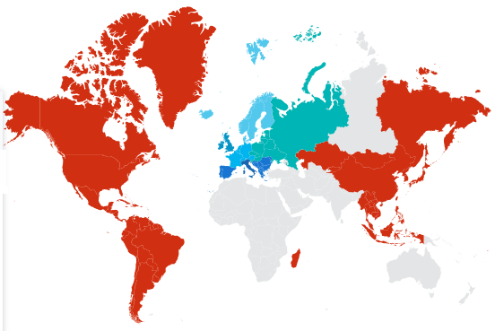
23andMe results

Slide 27
Also “Adam” or “Dr. Adam” or “Dr. Hrincevich”…
NEVER Mr. Adam!!! I am not a kindergarten teacher. This really drives me nuts…

Slide 28
Who: Dr. Adam Hrincevich
email.: zohrin@lsu.edu
phone: 578-7261 office
office hours: TBA, see syllabus
office: 366 Life Sciences Bldg.
The EASIEST and MOST EFFICIENT way to address your questions or concerns is to see me right before lecture starts or right after our lecture ends. I typically save time for these types of questions and can usually get you an answer at that time. That way, I know you are also attending lecture and are not asking something I have already addressed multiple times.

Slide 29
BIOL 1202 sections for Dr. Hrincevich
Section 2: 1:30-2:50 PM Tues/Thur 0101 OLOL ISB
Section 3: 3:00-4:20 PM Tues/Thur 0101 OLOL ISB
Section 4 12:00-1:20 PM Tues/Thur 228 Tureaud Hall
NOTE: I do NOT broadcast my lectures using ZOOM or post my complete lecture notes to MOODLE. You must physically attend lecture to get the notes. If you miss lecture, please get the notes from a fellow classmate.
I do NOT suggest that you sit in on another professor’s section since they may be covering the chapters in a different order.

Slide 30

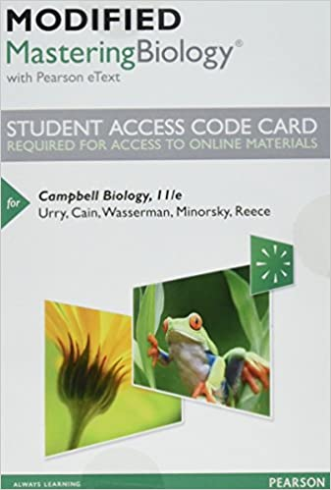
REQUIRED:
TEXT: Campbell, Urry, Cain, Wasserman, Minorsky, and Reece; Campbell Biology, 12th edition, ©2020. There are various formats available
  Looseleaf
  Hardbound
  Electronic text (e-text)
Mastering Biology access
Available in the LSU bookstore as a custom packaged edition that includes the MASTERING BIOLOGY ACCESS CODE. You can also purchase your Mastering Biology access code to include an electronic copy of the textbook (e-text) if you prefer that format. Pricing will vary depending on what vendor you use. Going through the Pearson Education publisher website is typically the cheapest option (see our syllabus for more information).

Slide 31

4.5
I use MOODLE extensively throughout the course to minimize paper handouts

Slide 32
ALL EXAMS ARE
COMPUTER-BASED
Can schedule any time within the 3 day window
120 minutes to take the assessment
Calculators, Whiteboards, and Markers provided
Himes Hall basement
MUST schedule assessment before taking it
Exams are scheduled through MOODLE
ADVANTAGE → Get your score immediately
BIG test bank
Students registered through Disability Service (DS) MUST take their exams through DS to receive accommodations (i.e. extended time, distraction reduced environment, etc.)

Slide 33
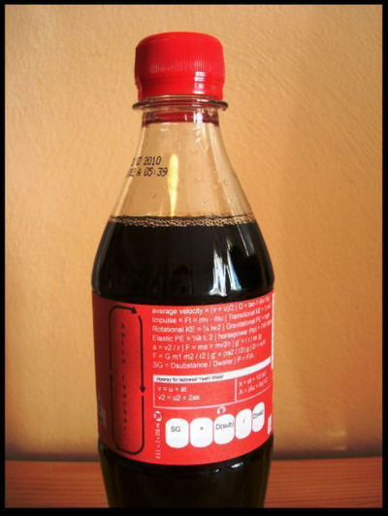
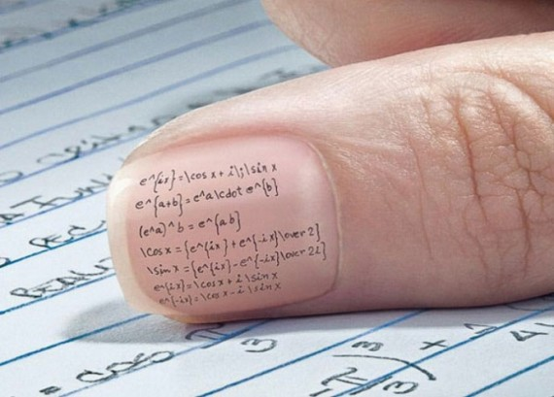
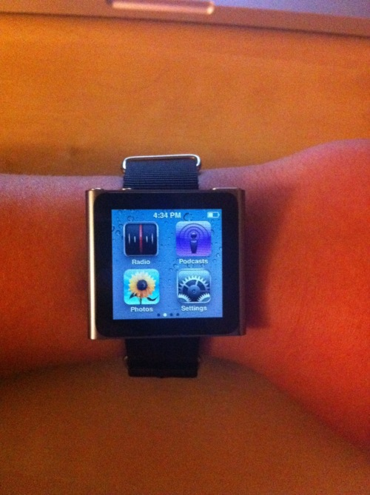
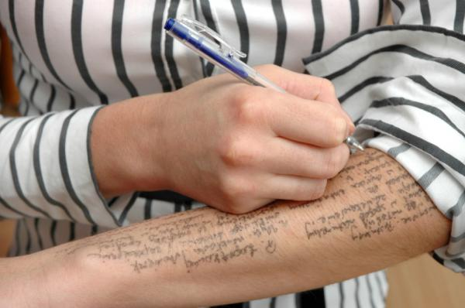
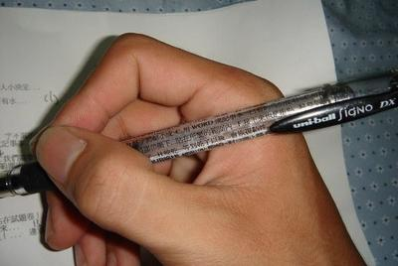
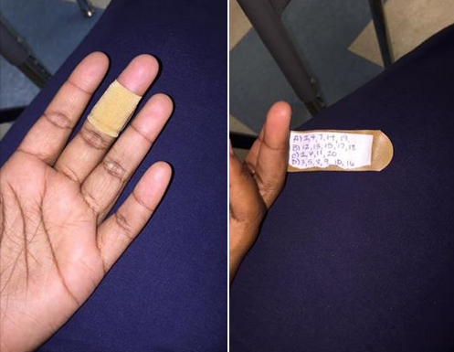
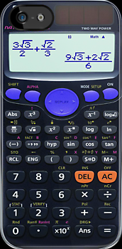
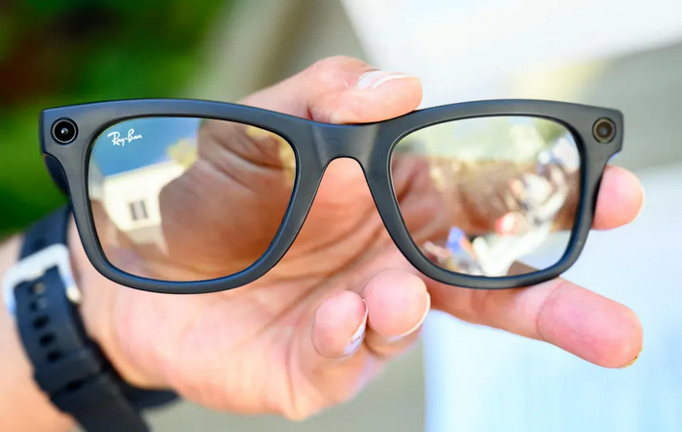
EXAMS
NOT word-for-word
everything from assigned reading is fair game
everything in class is fair game
4 exams total, NOT cumulative
We DO NOT drop an exam!!!
Bring photo ID to all exams!
ABSOLUTELY no cell phone use during exams.
Don’t even think about CHEATING…not worth it and the Testing Center is pretty up-to-date on the newest “techniques”…

Slide 34
MAKE-UP EXAMS
None except for University-approved absences
EMAIL me before missing the exam or within 24 hours after missing the exam. It is your responsibility to make arrangements with me if you miss (or will miss) your exam.
Documentation required (LEGITIMATE docs…)
Make-ups may be computer or may be short answer
It is your responsibility to print out and return (via email with documentation) to me the “MISSED EXAM FORM” which is located in MOODLE

Slide 35
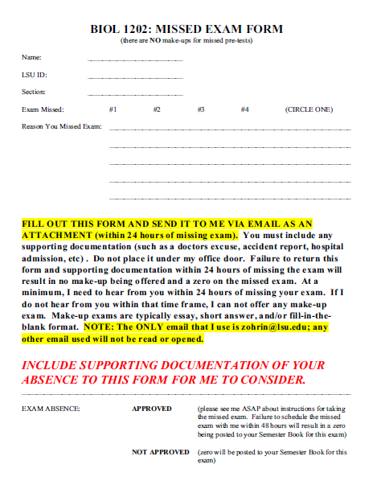
Make-up Exams
Form is posted to MOODLE and I need a completed sheet (with supporting documentation) before any make-up exam can be scheduled

Slide 36

GRADES
4 EXAMS: 90% of your grade (22.5% for each of the four exams). NONE of the exams are dropped! There are MUTIPLE resources for review materials which can be used to gauge how well you understand the material BEFORE the exam.
Mastering: 10% of your grade. At the end of the semester, I will drop 10% of your lowest scores (typically about 3 or 4 scores)
BONUS: There will be opportunities to earn bonus points during the semester. These may be based on attendance and others will be extra problem sets.

Slide 37
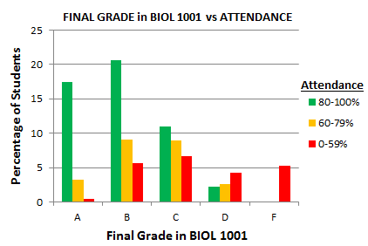
ATTENDANCE IS ABSOLUTELY IMPERATIVE FOR THIS COURSE!
FINAL GRADE IN BIOL 1202

Slide 38
Supplemental Instruction
SI Leader: Ravyn A. Thomas
Email: rtho223@lsu.edu
Office Hours: TBA
SI Sessions: TBA

Slide 39
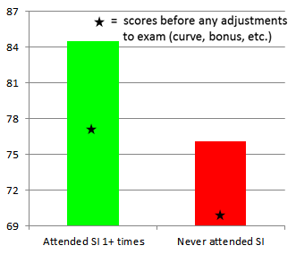
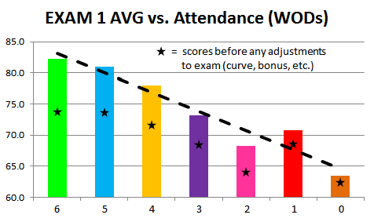

Slide 40
Grade distribution
GRADE | PERCENTAGE
A+ | 98.0% to 100.0%
A‍ ‍ | 92.0% to 97.99%
A- | 90.0% to 91.99%
B+ | 88.0% to 89.99%
B‍ ‍ | 82.0% to 87.99%
B- | 80.0% to 81.99%
C+ | 78.0% to 79.99%
C ‍ | 72.0% to 77.99%
C- | 70.0% to 71.99%
D+ | 68.0% to 69.99%
D‍ ‍ | 62.0% to 67.99%
D- | 60.0% to 61.99%
F‍ ‍ | 59.9% or lower

Slide 41
If you’re having problems…
Come talk to me, I am a great source of information!
I can’t help you unless I know that you need help.
Biology and Chemistry Tutorial Center
Center for Academic Success
141B Middleton Library
They offer FREE TUTORING
No appointment necessary
CLICK ME for their website and more information
Monday – Thursday 9:30 AM to 7:00 PM
Friday 9:30 to 3:00 PM*
*times may vary, check their website for information

Slide 42
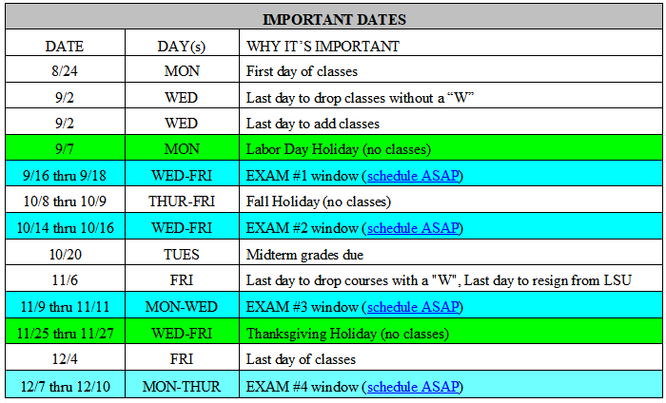
SAMPLE:
See our syllabus for current dates
* Exam dates/coverage are subject to change if necessary; based on University closures or weather events

Slide 43
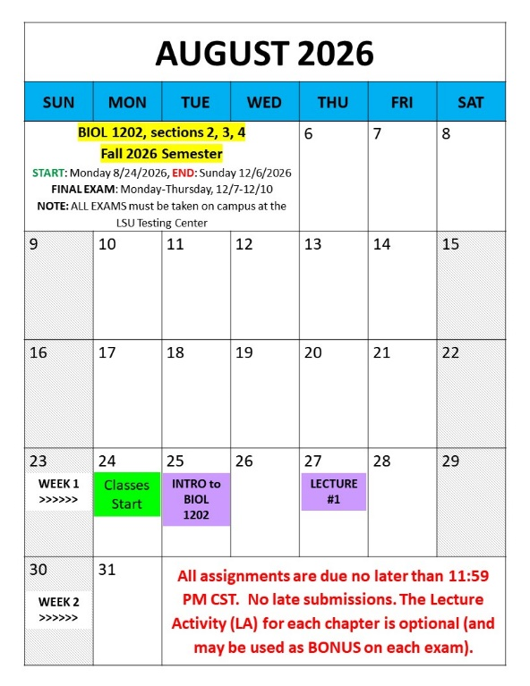
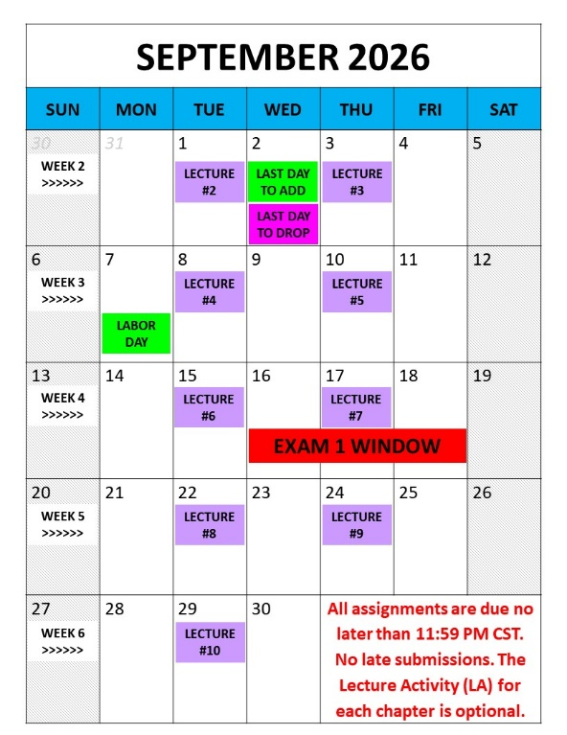
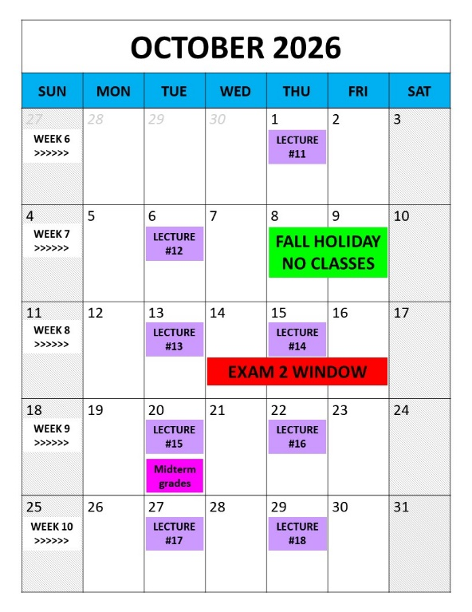
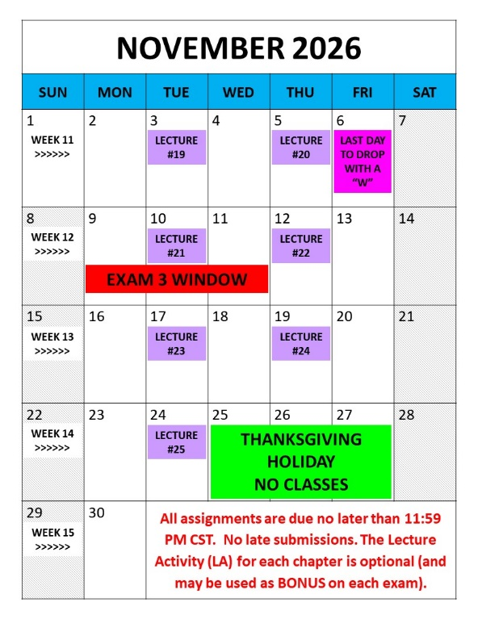
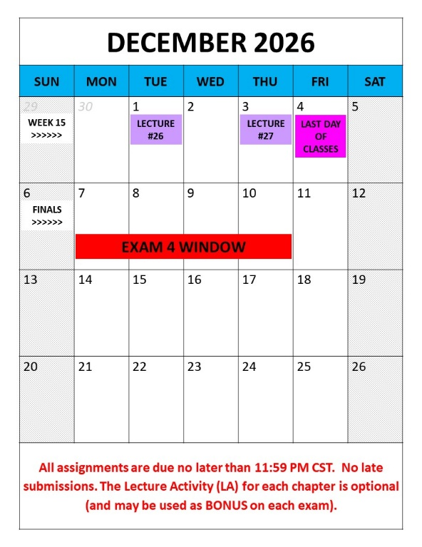
SAMPLE:
See our syllabus for current dates

Slide 44
SELECTED TOPICS TO COVER FOR BIOL 1202
CH 22 Descent With Modification: A Darwinian View of Life
CH 23 Evolution of Populations
CH 24 Origin of Species
CH 25 History of Life on Earth
CH 26 Phylogeny and the Tree of Life
CH 27 Bacteria and Archaea
CH 19 Viruses
CH 28 Protists
CH 29 Plant Diversity I: How Plants Colonized Land
CH 30 Plant Diversity II: The Evolution of Seed Plants
CH 31 Fungi
CH 32 An Overview of Animal Diversity
CH 33 An Introduction to Invertebrates
CH 34 The Origin and Evolution of Vertebrates
CH 35 Vascular Plant Structure, Growth, and Development
CH 36 Resource Acquisition and Transport in Vascular Plants
CH 37 Soil and Plant Nutrition
CH 38 Angiosperm Reproduction and Biotechnology
CH 40 Basic Principles of Animal Form and Function
CH 41 Animal Nutrition
CH 42 Circulation and Gas Exchange
CH 43 The Immune System
CH 44 Osmoregulation and Excretion
CH 45 Hormones and the Endocrine System
CH 46 Animal Reproduction
CH 47 Animal Development
CH 50 Sensory and Motor Mechanisms
CH 51 Animal Behavior
CH 52 An Introduction to Ecology and the Biosphere
CH 53 Population Ecology
CH 54 Community Ecology
CH 55 Ecosystems and Restoration Ecology
CH 56 Conservation Biology and Global Change
SAMPLE:
See our syllabus for current coverage topics

Slide 45
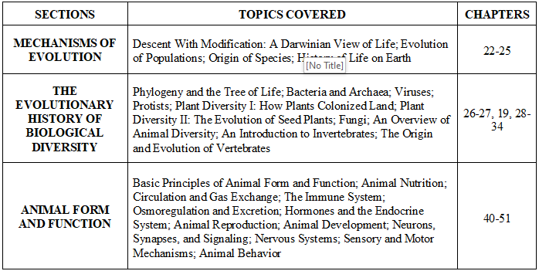
BIOL 1202 Lecture Schedule
0
In general, I try to cover the chapters in the order that they appear in the textbook. However, we may change the order depending on several circumstances (University closures, severe weather events, MOODLE technical problems, etc.). I like to add material from outside sources to our lectures, so it is imperative that you use my CHAPTER LECTURES that I post to MOODLE. If you try to create your own lectures outlines from the text, you may not be emphasizing the materials that I feel are the most important in order to perform well on the exam.

Slide 46
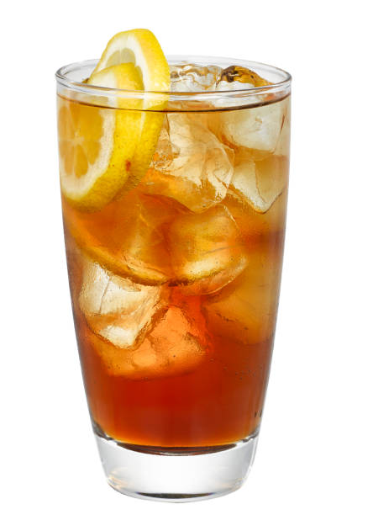
Iced tea incident…

Slide 47
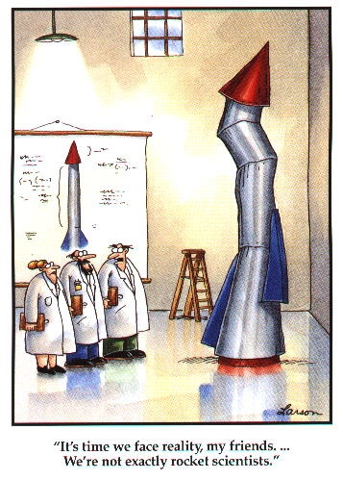
Relax…We’ll have some fun this semester

